Slide 1
Ptool Development Team Stand-up
November 7, 2019
Facilitated by: Ross Speir and Kyle Maddox
Human Factors Engineering (HFE)
Office of Health Informatics (OHI) (10P2)
Veterans Health Administration (VHA)

Slide 2
Agenda
Updates
Core Team Recruitment
Discussion: Focused Development
Briefing: Human Centered Design & Rapid Prototyping
Purpose
Goals
Expected Outcomes
Discussion: Dates and Team for Rapid Prototyping Workshop
Palo Alto VAMC Site Visit
My HealtheVet Patient Generated Data Portal
Exercise: Prioritize User Needs
Questions

Slide 3
Updates: Core Team Recruitment
Required Team Members
CAC – for CPRS/VISTA and Reminder Dialog expertise.
V9/TVHS has agreed to have a CAC join our team; waiting for specific individual.
Informaticist – for analytics, data warehouse and SharePoint dashboard design expertise.
FHIC or one of our tentative candidates.

Slide 4
Discussion
Could we develop the clinician facing component while we continue looking for Informaticist to join team for the dashboard?

Slide 5
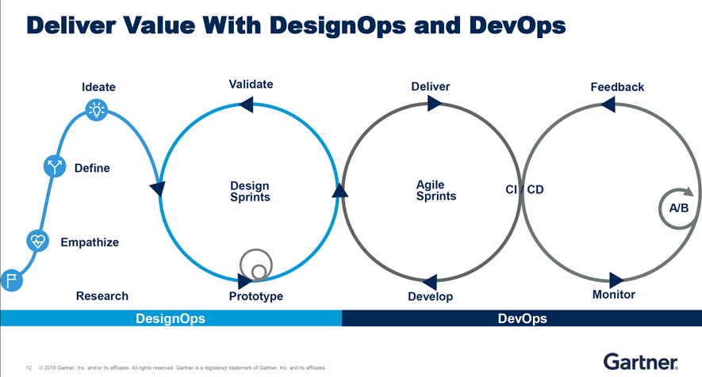
Human-Centered Design

Slide 6
Briefing: Rapid Prototyping
Iterative approach to the design stage of an application or website; goal is to improve the design via multiple quick cycles of iteration and evaluation. ~7 weeks from workshop to qual test.
MVP
Prototyping
Feedback
Improvement
Purpose of Workshop:
Prioritize: user needs and requirements
Prototype: translating ideas into functional representation
Review: developed evaluation strategy
Refine: identified backlog of unmet user and stakeholder needs (Pareto Principle)

Slide 7
Briefing: Rapid Prototyping
Rapid Prototyping Goals:
Quick prototyping to generate progress
Goal is to have a short cycle of 2-weeks or so at a time
Team focused on high prioritized/core features
Focus on critical features; Pareto Principle: 20% of features deliver 80% of impact
Focused on End-user
Collaborative development and feedback
Discover development risks early, saving us time and resources.

Slide 8
Briefing: Rapid Prototyping
Rapid Prototyping Expected Outcomes:
Lo-fidelity Ptool prototype to take to the field
“Paper” prototype -> wizard-of-oz technique
Wireframe -> visually representative, not interactive
Mockup -> lo-fidelity prototype, interactive but not finished
Feedback and Evaluation strategy
Each core team member might be asked to gather feedback from prospective end-users
Structure to facilitate iterative development and backlog

Slide 9
Discussion
Who should attend the rapid prototyping workshop?
HFE (Kyle and Ross)
CAC (TVHS)
Informaticist (Elliott)
Mental Health SME (Clinical > Dr. Lindley; Admin > Michelle?)
Systems Engineer (Dr. Burke)
Interaction Designer (Russ Beebe)
Best dates for rapid prototyping?
IRDC (Nashville) > prototyping workshop (November 18 – 21 or December 16 – 19?)
Palo Alto > field site for qualitative evaluation
Tentatively 7 weeks out from rapid prototyping workshop
Availability for My HealtheVet call?

Slide 10
Exercise: Prioritizing User Needs
“A user need statement is an actionable problem statement used to summarize who a particular user is, the user’s need, and why the need is important to that user.
It defines what you want to solve before you move on to generating potential solutions, in order to
1) condense your perspective on the problem, and
2) provide a metric for success to be used throughout the human-centered design process.”
- Nielsen/Norman Group

Slide 11
TVHS Discovered Design Objectives
Reduce patient drop-outs
Minimize documentation burden
Document/data duplication
Treatment recommendations should be useful and not proscriptive – will help with adoption
Align to providers skillset
Support SAIL metrics
Ensure quality analytics
Tool should promote better communication with the patient
Facilitate equity of care at CBOCs
Avoid overloading users with data; be succinct and actionable
Support staffing needs analysis
Provide measures that facilitate post-discharge treatment window timeframe/activities
Should share data with CPRS
Should utilize a generic and collaborative intake that providers build on collaboratively over time
Increases transparency and reduces Veteran’s need to repeat their story

Slide 12
Questions?

Slide 13
For More Information
Study Series Lead(s):
Kyle Maddox (VHA OHI HFE, Kyle.Maddox@va.gov) Ross Speir, (VHA OHI HFE, Ross.Speir@va.gov)
HFE Points of Contact:
Kurt Ruark, HFE Acting Director (Kurt.Ruark@va.gov)
13

